Slide 1
Remoteness
Yr 7 HASS- Geography

Slide 2
Write down the definitions
Urban: an area characterised by a higher population density and build feature than the area around it.
Rural/Regional: an area that has a low population density and where the land is typically used for agriculture.
Remote: a geographical area where a community is located over 350km from the nearest service centre having year-round road access.

Slide 3
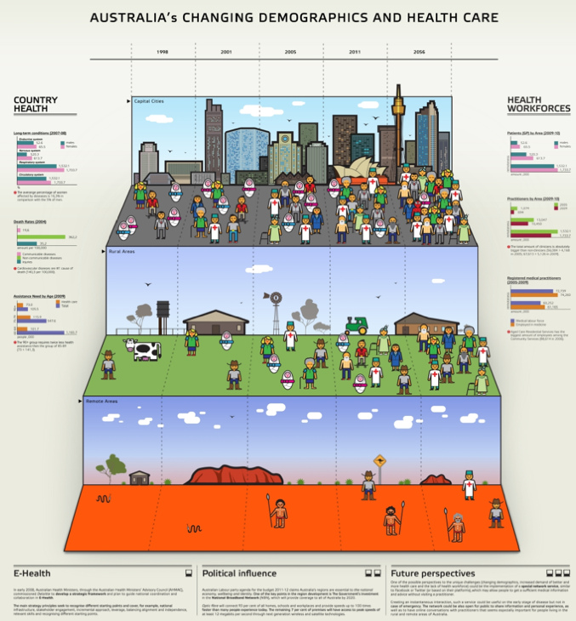

Slide 4
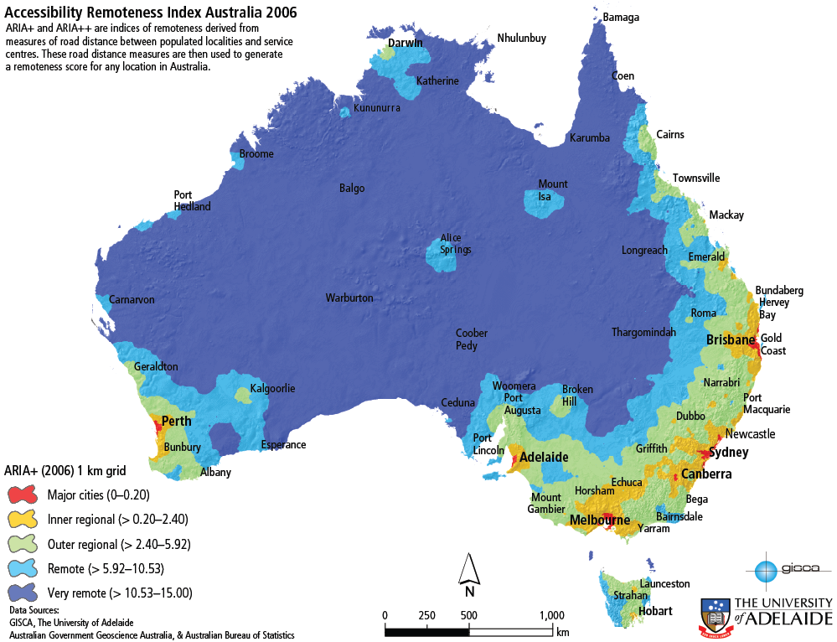

Slide 5
Classification
Major cities – 66%
Regional – 31%
Inner
Outer
Remote- 3%
Remote
Very Remote

Slide 6
Sort the words into the correct category (Urban, Rural, Remote)
Swimming pools
City skyscrapers
Highways
Roads
Storage sheds
Dams
Houses
Apartments
Stables
Traffic lights
Hotels
Bus stations
Train stations
Airports
Cafes
Petrol stations
Parks
Skate parks

